Slide 1


ACCESSING GENDER AFFIRMING CARE IN MANITOBA
Presented by Klinic Community Health – TransHealth Klinic

Slide 2
AGENDA
Introductions
Inclusive Language and Definitions
Accessing Gender Affirming Care
Q & A

Slide 3
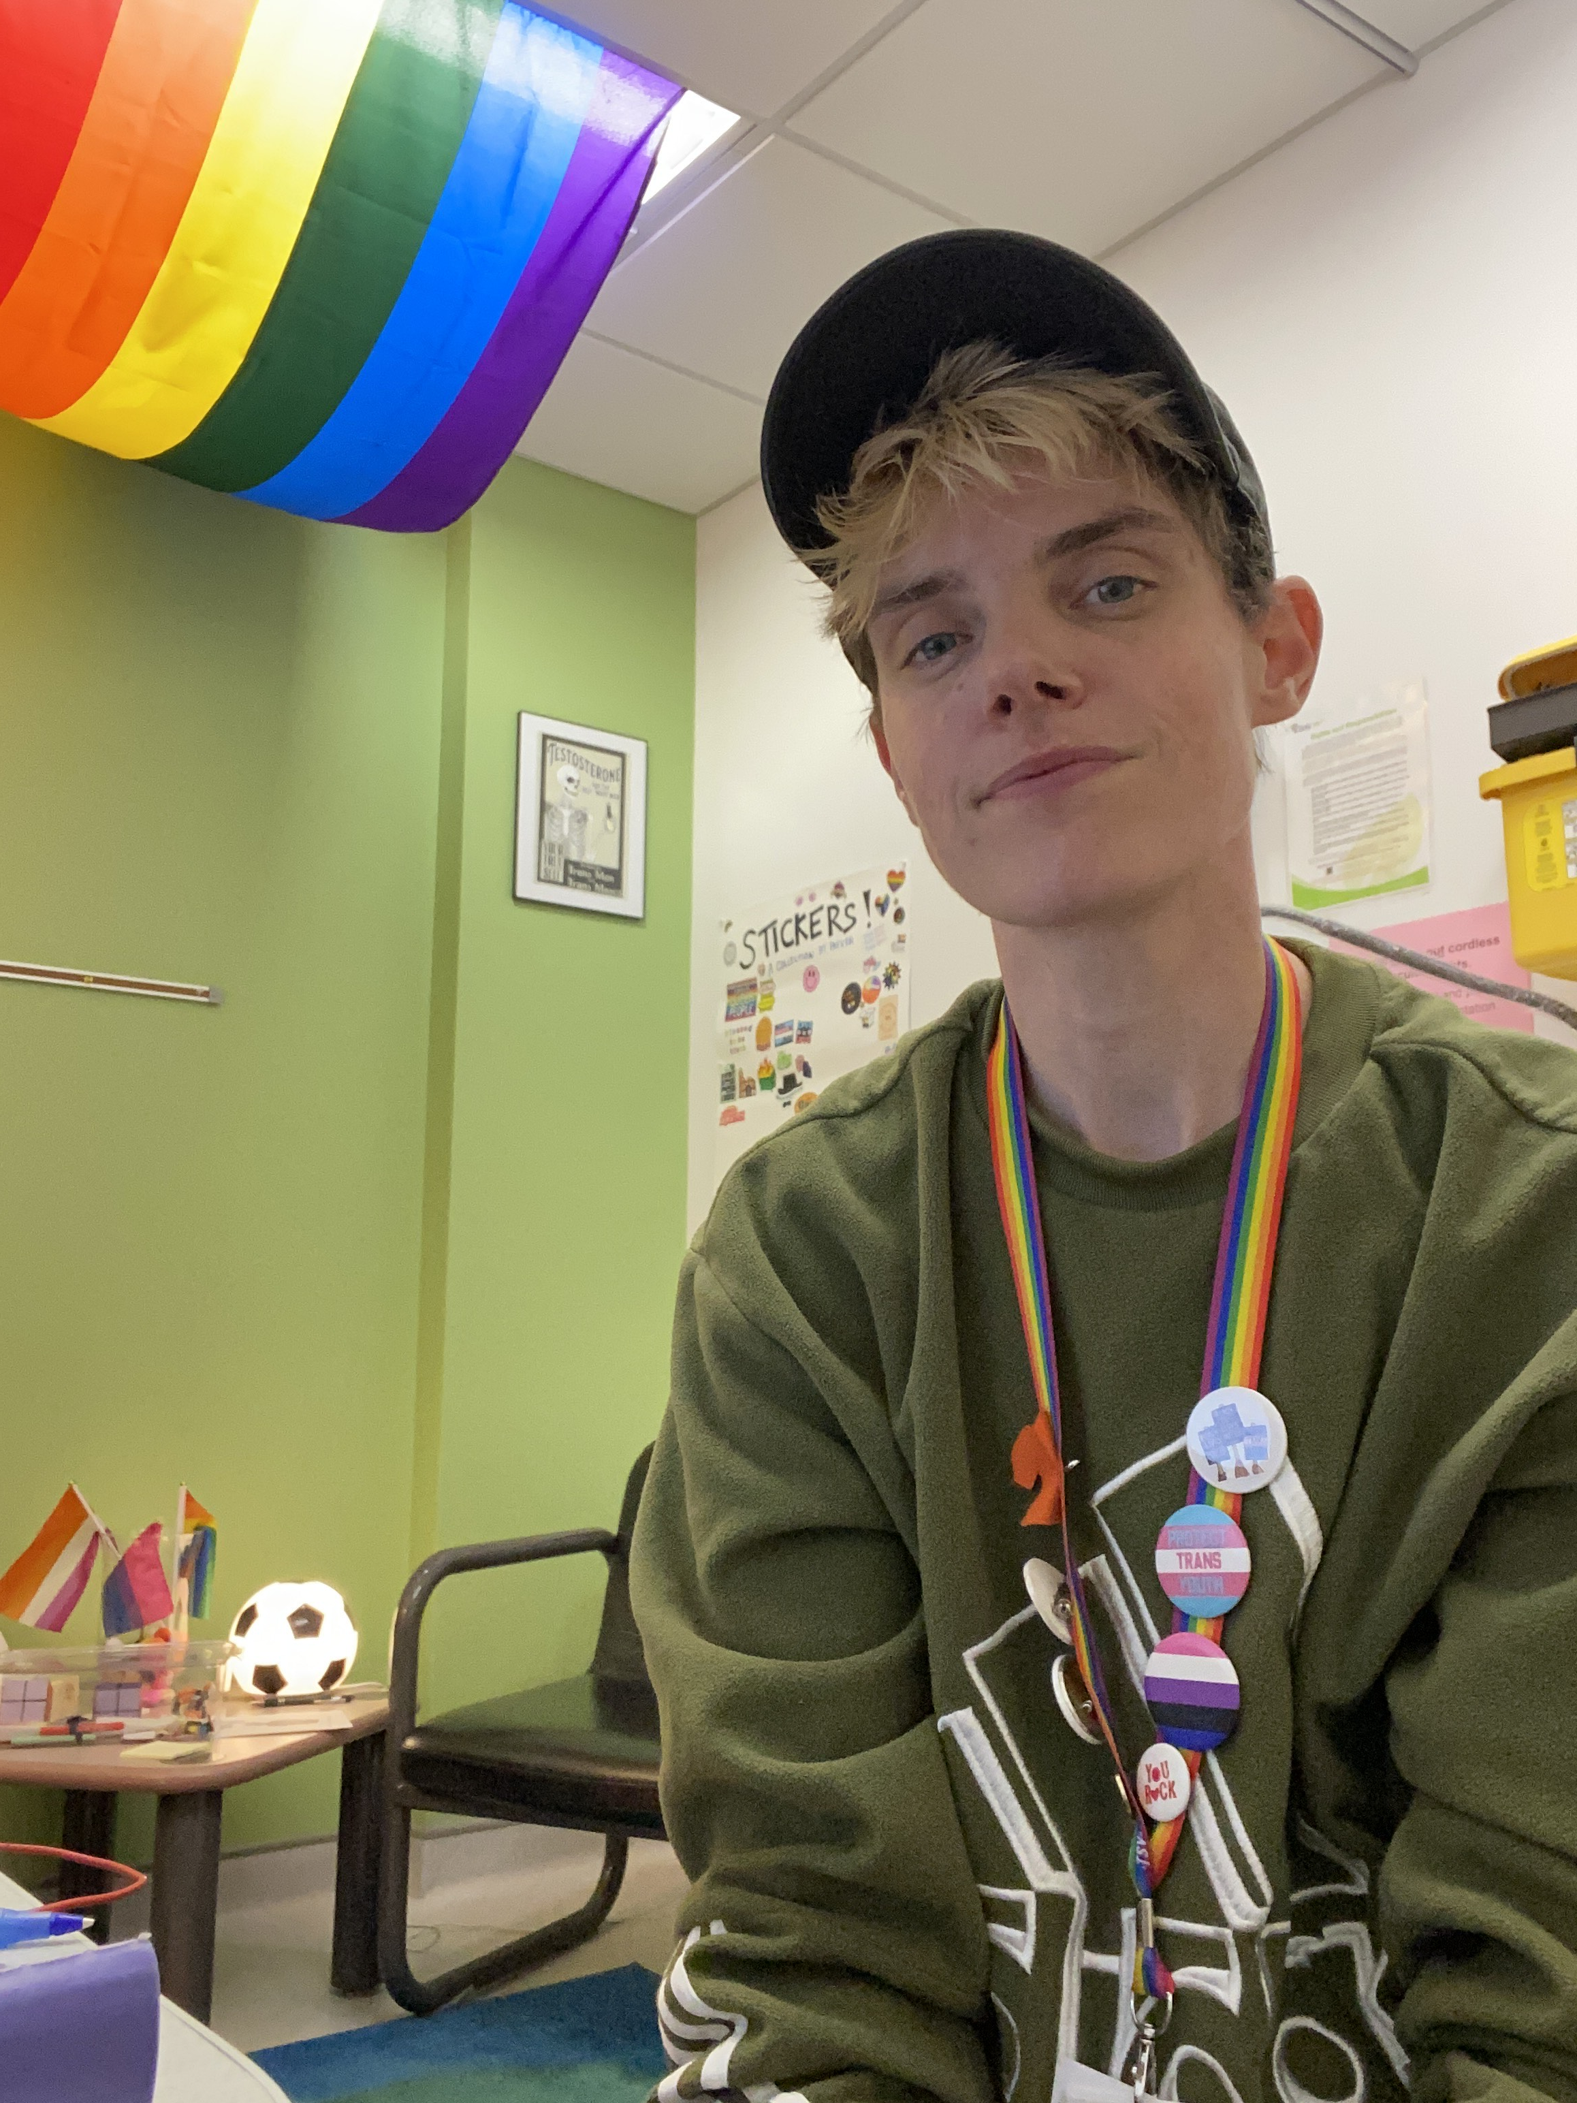
PARKER MORRAN (they/them)
Position: Trans Health Social Worker

Slide 4
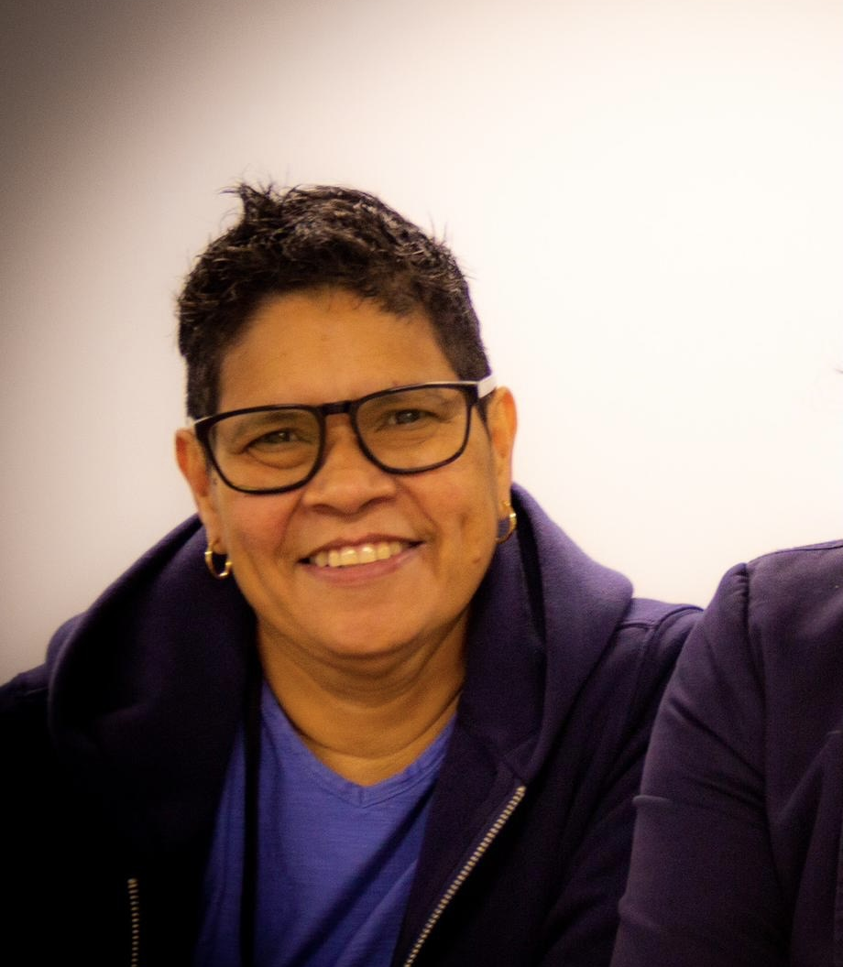
ALBA LOPEZ-GOMEZ (she/they)
Position: Peer Support Worker – Parents/Family

Slide 5
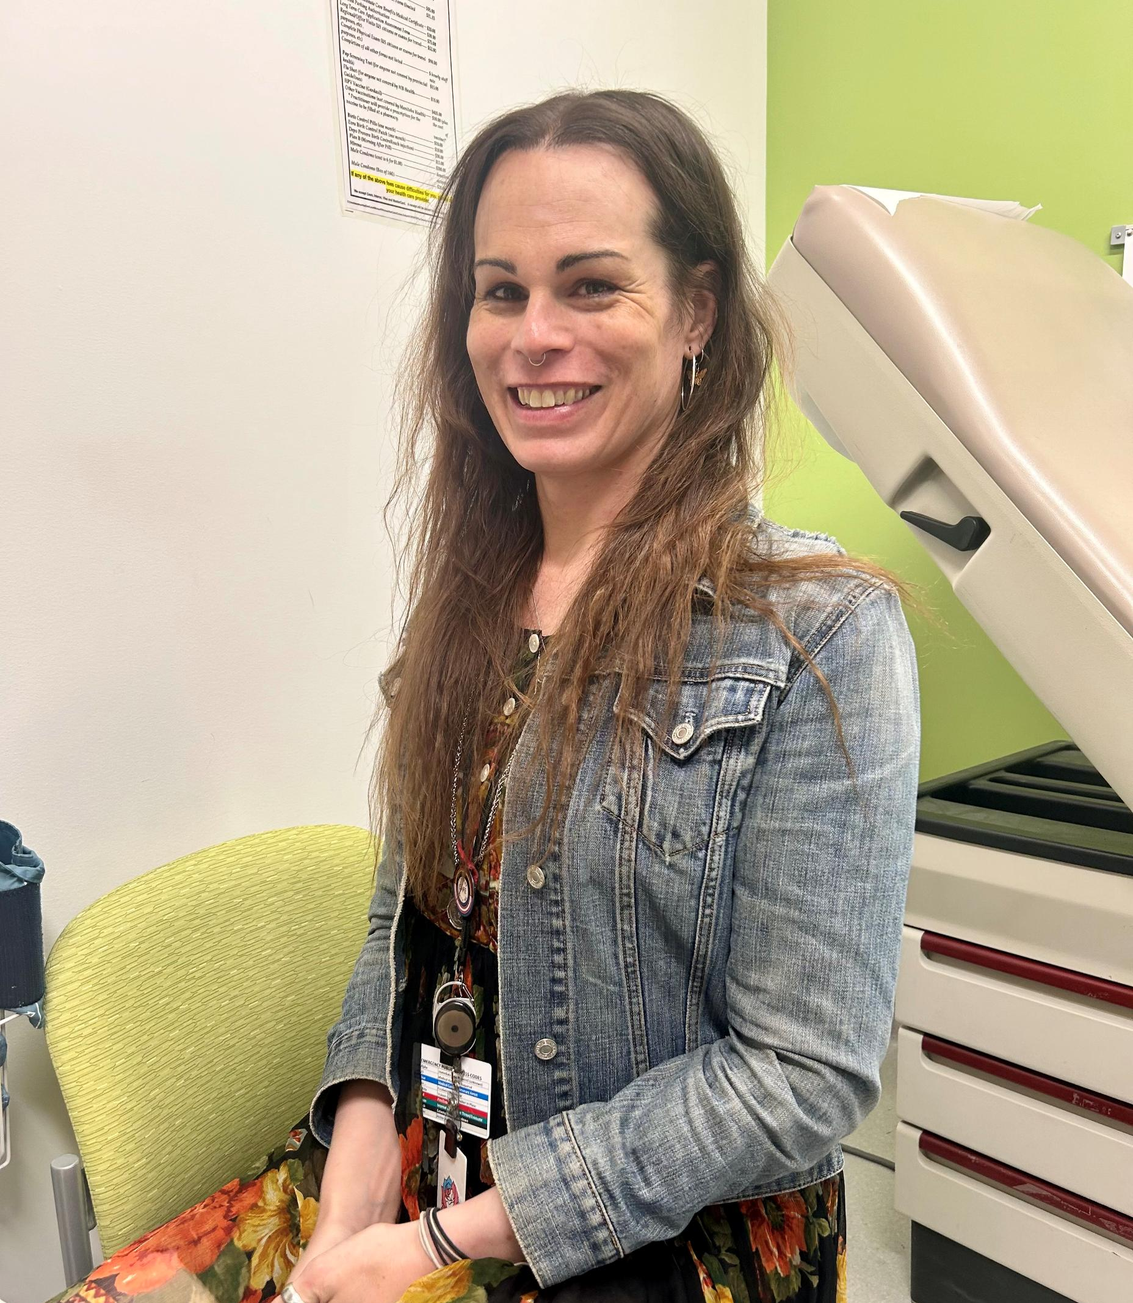
ASHLEY GAWNE (she/they)
Position: Peer Support Worker

Slide 6
INCLUSIVE LANGUAGE AND DEFINITIONS
A BRIEF OVERVIEW

Slide 7
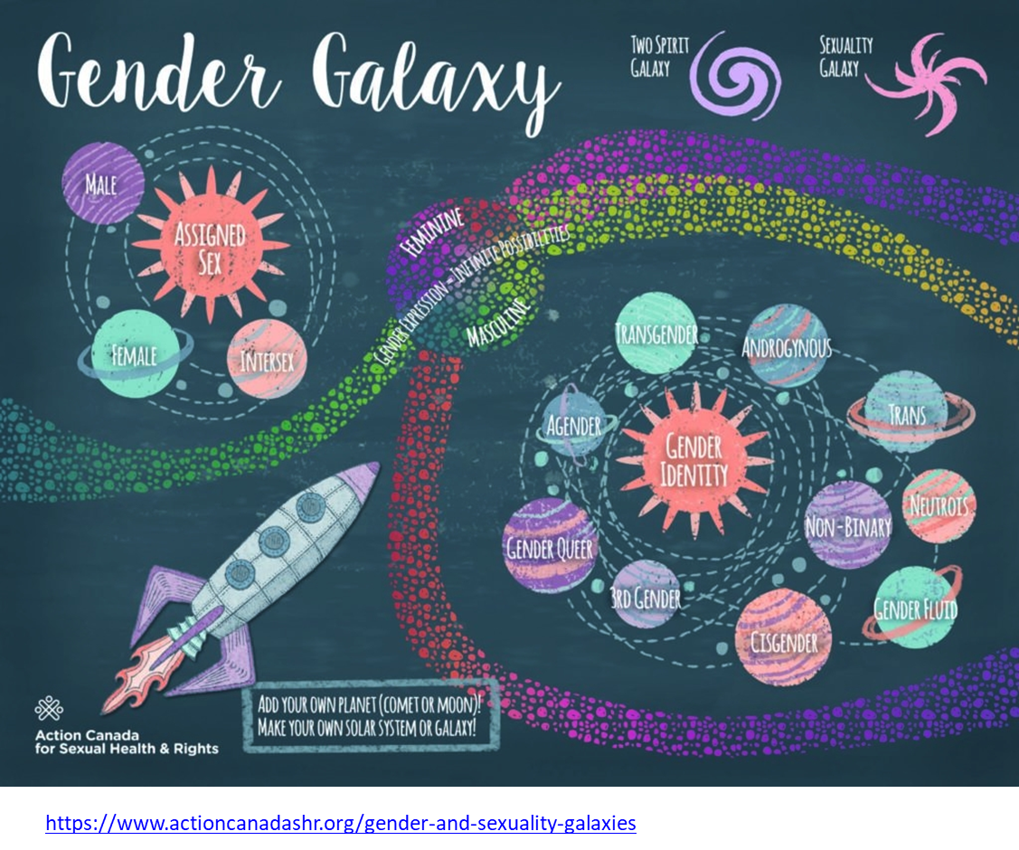
Notes:
Visual slide meant to demonstrate in a colourful way how ones’ sex at birth is/can be separate from their gender identity. Gender identity is diverse and expanding in a galaxy of discovery and freedom of expression. The asteroid belt signifies societal standards currently imposed on us – feminine and masculine, but also acknowledges that there are infinite possibilities to explore. Beyond, are the separation of sexuality from gender identity (star shape in background), and Two Spirit identities.

Slide 8
Definitions:
Gender Affirming Care
  Formal systems and practices that affirm and support individuals’ gender identities.
  Can include social and psychological support alongside medical care and procedures.
Cisgender vs Transgender
  Cisgender: someone whose gender identity is the same as their assigned sex at birth.
  Transgender: someone whose gender identity does not match their sex at birth.
Gender Diverse
  An umbrella term that refers to people who do not identify as exclusively male or female.
Notes:
Gender Affirming Care in the context of this presentation is referring to medical transition care.
Cisgender people also access gender affirming care (plastic surgery, breast reductions/augmentations, hair transplants, etc.)
Ashley – talk about cis/trans
Gender diverse – non-binary, genderfluid, agender, etc.

Slide 9
Helpful Definitions (cont.):
Transfeminine / Transmasculine
  Umbrella terms for individuals who identify as trans female / trans male. Inclusive of non-binary/gender diverse identities.
Gender Incongruence
  Incongruence between an individual's gender identity and the sex assigned at birth.
  People with gender incongruence may identify is trans or gender diverse.
Gender Dysphoria
  Feeling of discomfort or distress because of gender incongruence.
  Not everyone who has gender incongruence experiences gender dysphoria.
Notes:
Terms used in gender affirming care context to help direct an individual’s transition goals. Does not always refer to someone seeking a medical transition.
Gender Incongruence – explained:
Can be felt physically (internal) or socially (external).
Gender dysphoria – defined in the DSM-5 and used more commonly in society and medical settings. Currently required as a diagnosis for transgender and gender diverse people in MB as a “gateway” to accessing transition care.
Source: WPATH – SOC8; Klinic website

Slide 10
WHAT IS THE TRANS HEALTH KLINIC?
KLINIC.MB.CA/TRANSHEALTH

Slide 11
Trans Health Klinic:
We provide gender affirming care throughout Manitoba – including rural areas and not limited to Winnipeg.
We see transgender and gender diverse individuals who are 16+
Gender Dysphoria Assessment and Action in Youth (GDAAY)​ is a program through HSC for ages 8-14.

Slide 12
Get To Know Our Team
Providing medical transition care, mental health supports, service navigation, referrals and resources, lived experience (peer) support, etc.
Admin Staff | Supports / Mental Health Team | Medical Team
Medical Assistant | Peer Support | Nurses
Intake Admin | Social Work | Nurse Practitioner
Front Desk | Psychologist | Doctors

Slide 13
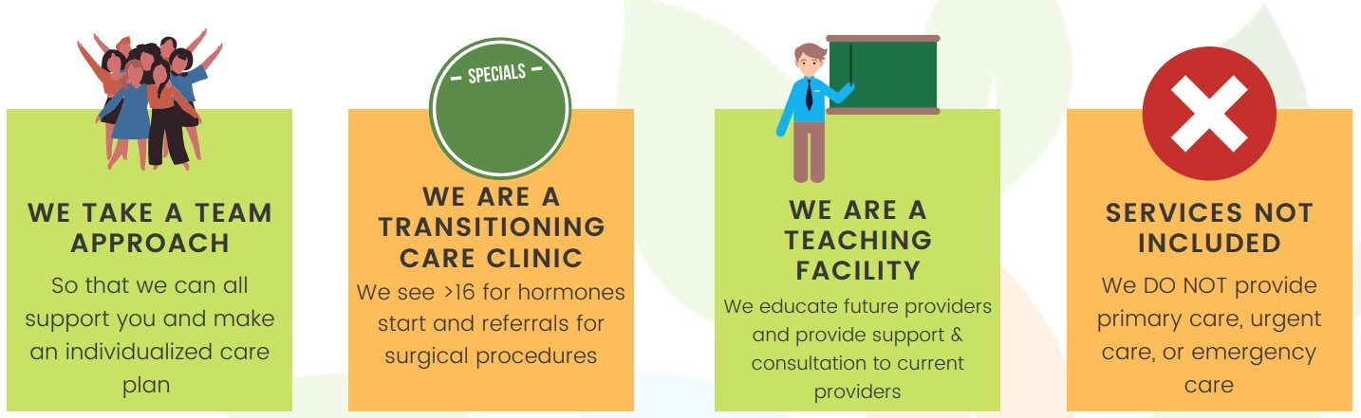
What to Expect:

Slide 14
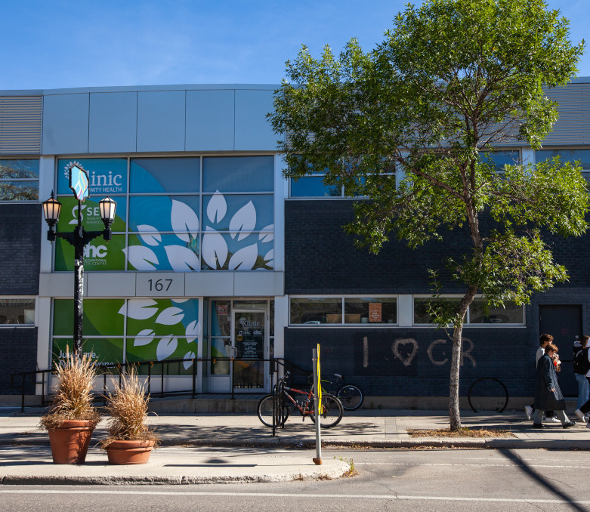
Our Building – 167 Sherbrook Street, Winnipeg
Visitor Parking
Scent-Free Facility
Wheelchair Accessible
Other Programs
Notes:
Parking in the lot in the back – labelled spots. 2hr street parking around the area.
Accessibility needs can be accommodated – please advise.
Front Desk are managing multiple programs within Klinic. Will ask for your health card and birthdate when you arrive and direct you where to go.
Klinic programs – Hummingbird, Counselling, Primary Care, Crisis lines, SERC, etc.

Slide 15
HOW TO ACCESS GENDER AFFIRMING CARE
Trans Health Klinic Process

Slide 16
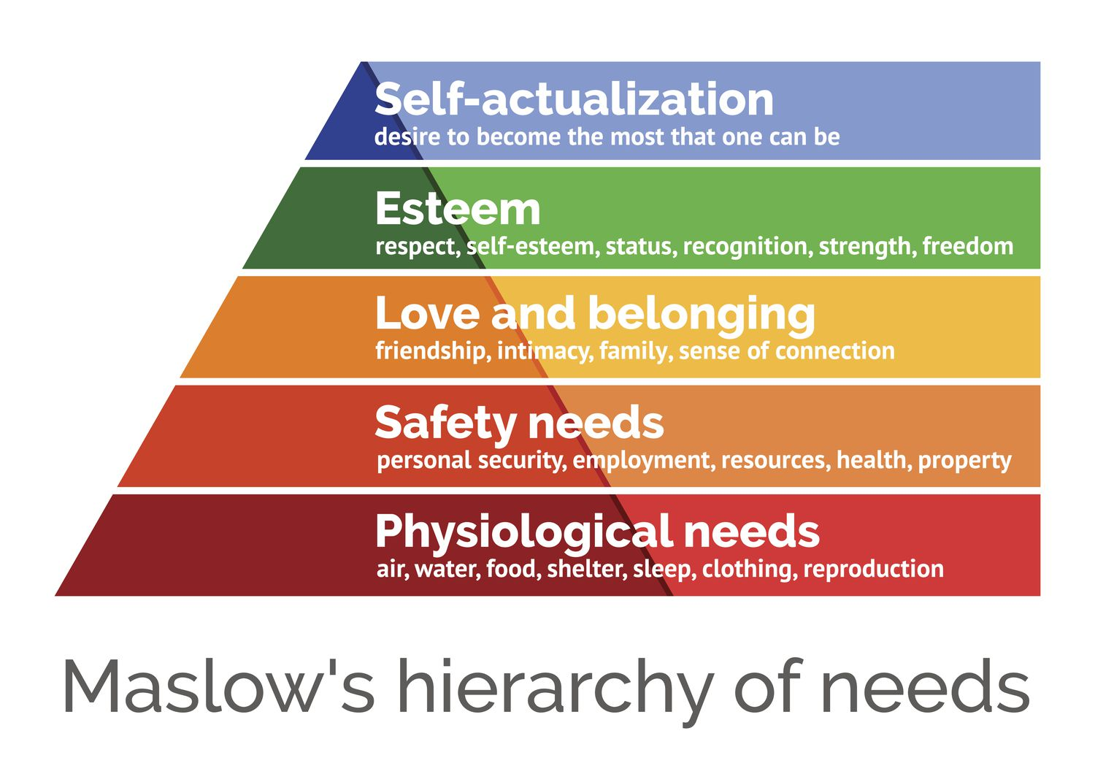
Barriers to Accessing Care:
Social
Political
Cultural
Location
Transportation
Financial
Housing
Physical Health
Mental Health
Substance Use
Accessibility
Etc.
Notes:
Relationships – family, romantic, roommates, etc.
Physical safety in one’s community, workplace, or home.
Policies
Rural barriers to healthcare, in additional to Klinic’s location in Winnipeg.
No health insurance or other coverage for hormones, unable to afford time off work for surgery, etc.
Housing instability.
Impact on ability to start or continue aspects of a medical transition (hormones, surgery).
Impact on ability to be well enough for appointments.
Impact of psychosis, significant mental health affecting ability to consent or have stability for surgery.
Substance use – heavy use of some substances can affect ability to consent. Smoking before surgery barrier.
People of colour, individuals with disabilities, newcomers / language barriers, individuals involved in the child welfare system, etc.
Neurodivergencies and Trans/Gender Diverse community crossover is very high.
Trans/gender diverse people are a marginalized community and at higher risk for adverse experiences in the medical field. Stigma and risk of discrimination rises when they are involved with other systems (mental health, child welfare, addictions, corrections, etc.). It can be hard to navigate a system that already has barriers in place when basic needs are not met. Takes a lot of safety privilege and self-advocacy to be able to access affirming medical care, never mind gender affirming care.

Slide 17
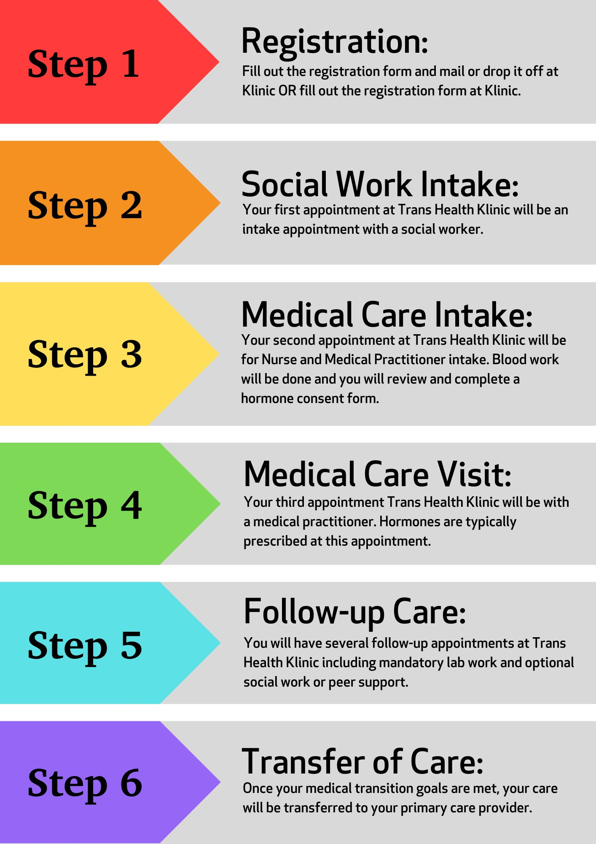
Step by Step Process
Notes:
Waitlist (intake): 10 months-1 year
Hormone start: 1-2 months after intake (variable)
Surgery referrals: Variable depending on desired surgery and/or surgeon.
Voice therapy: 2-3 years
Hair removal: variable
Social Work Intake:
First appointment after waitlist.
Review of Trans Health Klinic program – referrals, requirements and other available services.
Discussion of transition goals, gender identity, personal life situation.
May include topics such as mental and physical health, family, friends, support system, substances, etc.
Medical Intake:
Scheduled after social work intake.
Review of medical history and physical health (diagnoses, medication, etc.).
If starting HRT – bloodwork done.
Discussion with provider about gender incongruence and transition goals.
Other referrals discussed and initiated.

Slide 18
How to Register:
Self-Referral
  Form available to print on Klinic’s website (klinic.mb.ca): Health Care Services > Trans Health Klinic > Community Members
    Mail or fax to Klinic Community Health
  OR complete form and drop off in person at Klinic Community Health
2) Request a Referral from your Primary Care Provider
Notes:
Other supports available at any time while on the waitlist or during medical transition process – social work, peer support.
If further referrals are decided later, individuals do not need to re-refer to go back on the waitlist. Contact TH Klinic and request an appointment at any time.
Make sure to update information if it changes – call Klinic Front Desk. And make sure information is updated with your doctor if they refer you.

Slide 19
GENDER AFFIRMING PROCEDURES/SURGERIES​
Hormones – can be fully or partially covered ​ PHARMACARE, EIA, NIHB OR INSURANCE BENEFITS​
Upper surgery – chest masculinization, reduction, and augmentation – Covered by MB Health ​ WINNIPEG, MB​
Lower surgery – vaginoplasty, metoidioplasty, phalloplasty – Covered by MB Health​ GRS MONTREAL​
Hysterectomy with or without oophorectomy – Covered by MB Health WINNIPEG, MB​
Orchiectomy – Covered by MB Health WINNIPEG, MB​
Laser hair removal – Covered by MB Health​ WINNIPEG & BRANDON, MB​
Voice therapy – Covered by MB Health (at Deer Lodge Centre) WINNIPEG, MB​
GENDER AFFIRMING PROCEDURES/SURGERIES​
Facial feminization & Adam’s apple shaving – not covered​ WINNIPEG OR MONTREAL​
Materials (binders etc.) – not covered​ * Chest compression vest – covered by EIA, NIHB
Legal I.D change – only covered by E.I.A​ (other community resources available) WINNIPEG, MB​ ​

Slide 20
Hormone Replacement Therapy (HRT)
Testosterone – “masculinizing”
Estrogen – “feminizing”
Informed consent process to start hormones.
Need a diagnosis of Gender Dysphoria / Gender Incongruence by a practitioner (usually done at medical intake).
Can also be prescribed by your primary care provider.
Notes:
Hormones:
Testosterone: injections, Testosterone gel (androgel).
Estrogen / Testosterone blocker: pills, patches, injections (not available in Manitoba).
Most people start hormones within a month or two of their first appointment.
Barriers to starting HRT are discussed on a case-by-case scenario.
Health, social, financial, etc.

Slide 21
Gender Affirming Surgeries – Referral Requirements
(MB HEALTH)
Upper Surgeries | Lower Surgeries | Facial Feminization
Medical provider letter (Gender Dysphoria) | Medical provider letter (Gender Dysphoria) | Requires referral from TH Klinic providers. Requires mental health assessment. Coverage by MB Health will be determined on a case-by-case scenario.
Mental health provider letter (surgical readiness assessment) | Mental health provider letter (surgical readiness assessment)
Age 16+ | Age 18+
No HRT requirement | At least 6 months on HRT (except hysterectomy & orchiectomy)
Notes:
Upper Surgeries – “top surgery”:
Chest Masculinization
Breast Reduction
Breast Augmentation
Lower Surgeries – “bottom surgery”:
Phalloplasty, metoidioplasty (GRS Montreal)
Hysterectomy with or without oophorectomy (Manitoba)
Vaginoplasty (GRS Montreal)
Orchiectomy (Manitoba)
Timelines vary depending on referral.

Slide 22
OTHER…
Fertility Treatment Referral (not covered by MB Health)
Laser Hair Removal
Voice Therapy
Social/Mental Health Supports
Info Sessions and Groups (TBA)

Slide 23

What can you do?
  Avoid assumptions
  Respect pronouns and names
  Share your own pronouns!
  Mirror language
  "Inviting in" vs. expectation to "Come out"
  Maintain confidentiality
  Create inclusive spaces (eg: forms, bathrooms, signage)
@MEGEMIKOART
Notes:
Call back to the definition of allyship, adding pieces on social location and self-reflection and privilege
Avoid assumptions – Not assuming people’s gender, body parts, sexuality etc. based on their presentation, knowing that this is fluid and may change over time.
(i.e. I am a queer, genderfluid/transmasculine person). The medical model can be far more “binary” and it may be difficult for those who are providing care to assess what needs an individual has based on their sexuality or gender identity.
Respect pronouns and names
Mirror language – Using the identities, labels, etc., that people use to identify themselves. Medical care and what client is requesting is more important even if their identity may not align in the provider’s mind.
"Inviting in" rather than putting the onus on others to "come out"; create open, non-assumptive space for information to be revealed on their terms (avoid othering/more empowering). "coming out" creates onus to "confess" to being something other/undesirable/abnormal. No parallel expectation for cis/het. Ideas of "one big event", sets stage for victim blaming.
Maintain confidentiality – Speak to the idea of “outing” and harmful and dangerous this can be
Creating inclusive spaces: check intake forms are inclusive, have inclusive washrooms, put up posters/art etc.
Autonomy – Privacy of identities, particularly with youth. Respect their decision to share with you, amd who you share their identity with.
Youth: make sure to check in with them about their support system and who knows about their identity.
Avoiding stereotypes – for me, everything is about being trans because it’s my job and my life but some people just want to talk about having a cold.
Other stereotypes include that being trans means you will have challenges associated with housing, substance use, mental health, etc.

Slide 24
Resources & Supports
Trans Health Klinic Peer Support Team & Social Work (in person or virtual supports)
Rainbow Resource Centre
2Spirit Manitoba
SERC
GSA’s / University 2SLGBTQ+ Student Support Groups
Sunshine House (Winnipeg)
Youth Huddles (Winnipeg, ages 14-29)

Slide 25

Crisis Supports
988: Suicide Crisis Helpline (24/7).
Phone or Text – 988
Klinic Crisis Line (24/7)
Phone: (204) 786-8686
Toll free: 1-888-322-3019
Manitoba Suicide Prevention &
Support Line (24/7)
Toll free: 1-877-435-7170 / www.reasontolive.ca
Sexual Assault Crisis Line (24/7)
Phone: (204) 786-8631
Toll free: 1-888-292-7565
Trafficking Line (24/7)
Toll Free: 1-844-333-2211
Manitoba Farm, Rural & Northern Support Services (24/7)
Toll free: 1-866-367-3276
www.supportline.ca
Kid’s Help Phone
Text CONNECT to 686868
1-800-668-6868

Slide 26

Q & A
ASK US ANYTHING!!

Slide 27

Thank you!
Trans Health Klinic - Klinic Community Health
Peer Support: 204-784-4016
Parker: 204-259-3927 pmorran@klinic.mb.ca

